Slide 1
中西文化差异

Slide 2
01
Etiquette culture
CONTENTS
02
Food culture
03
My feeling

Slide 3
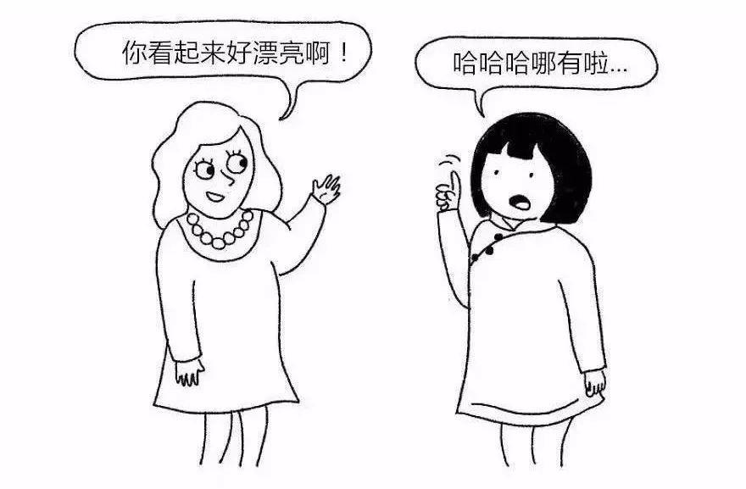
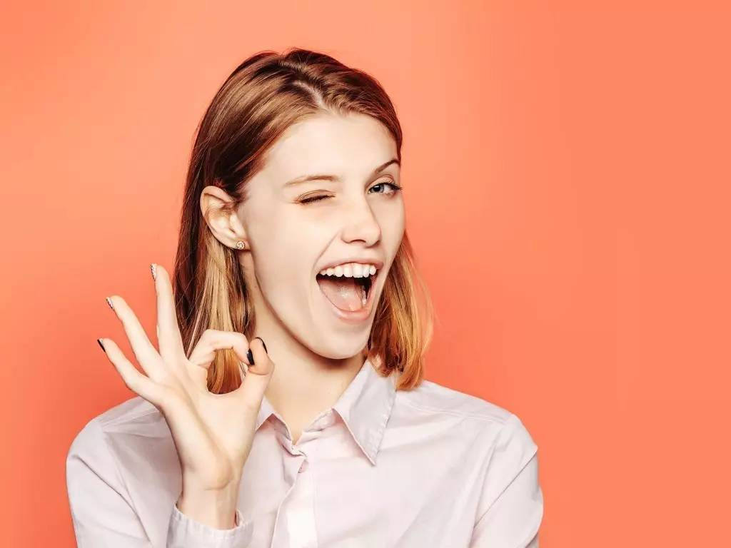
When we face praise from others
Thank you！
01
01
We always politely deny other people‘s praise to show humility，However, Westerners' attitude towards praise can be described as "beaming with joy".

Slide 4
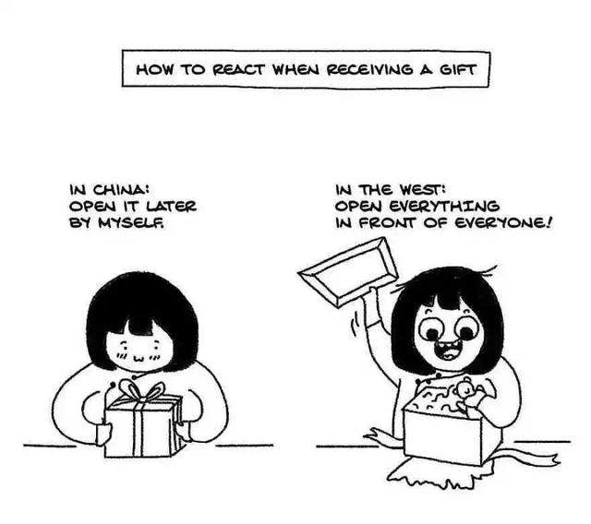
When we face other people's gifts
01
01
Most of us don't open the gift package. If you open the gift package in front of the giver, you are suspected of valuing profit over righteousness. When Westerners receive gifts, they usually open the gift package in front of the giver and express appreciation for the gift. If you don't open the gift package in person, the giver will think that you don't like the gift.

Slide 5
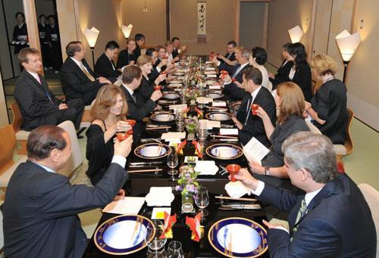
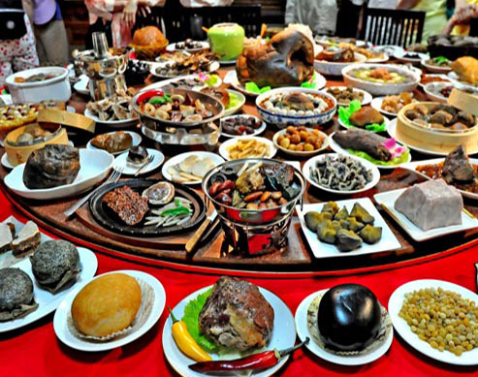
Differences between Chinese and Western parties
02
02
Westerners pay attention to delicacy,
while Chinese people pay attention to show off .

Slide 6
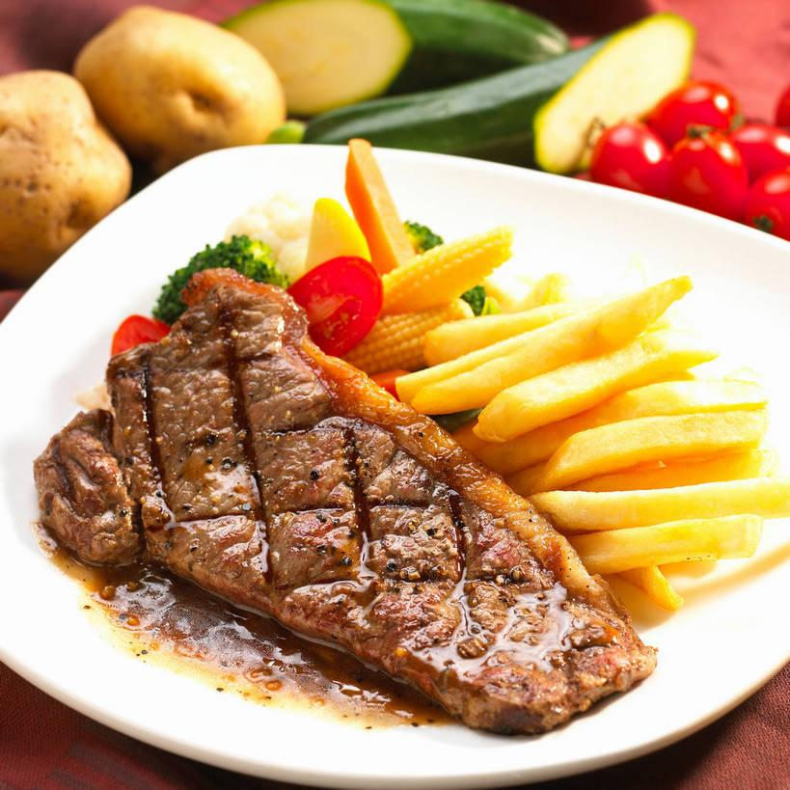
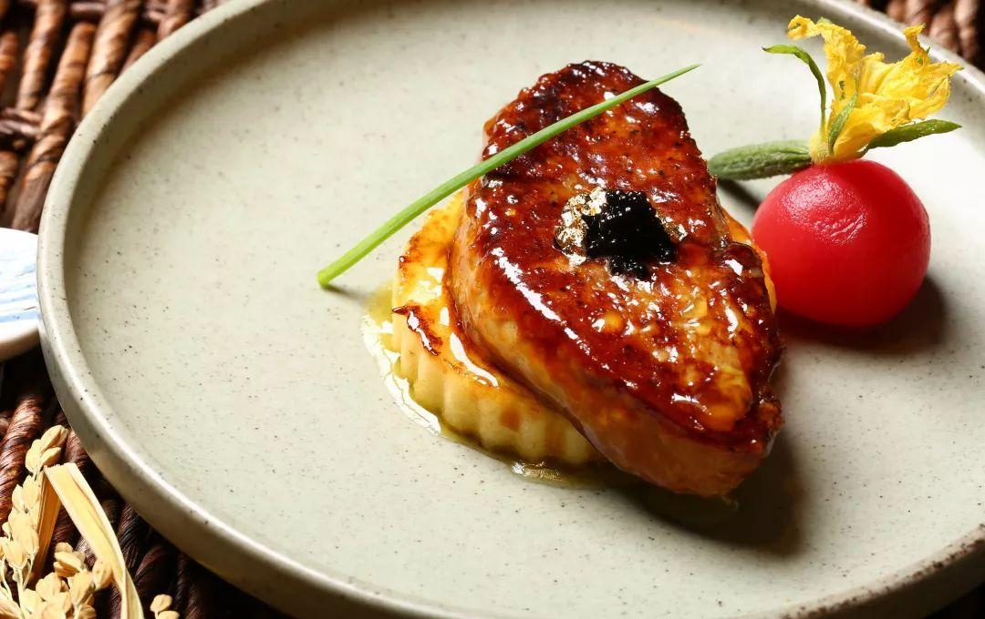
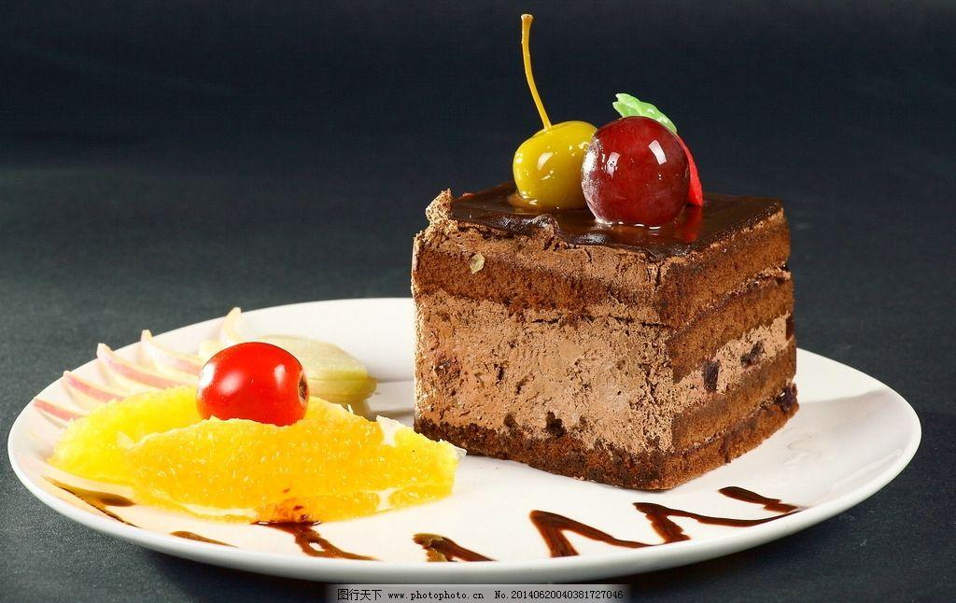
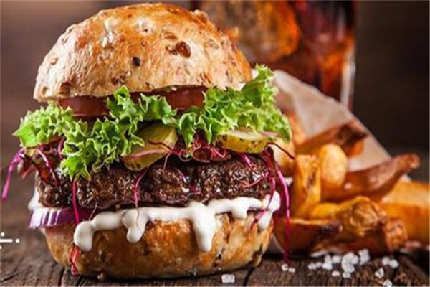
Western food
02
02

Slide 7
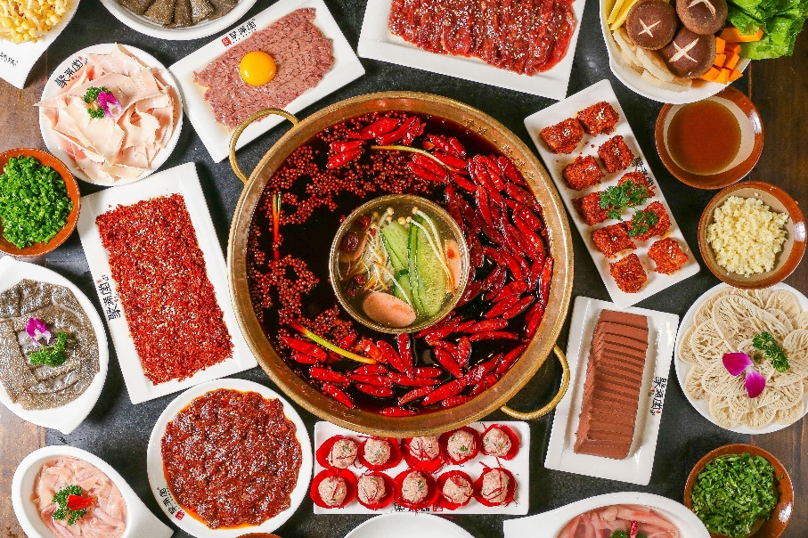
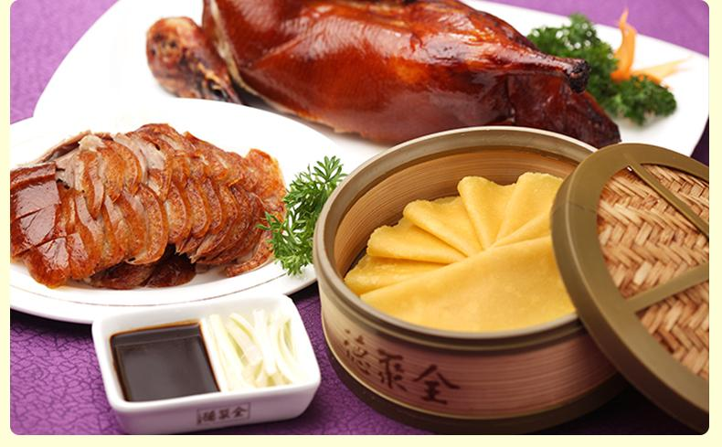
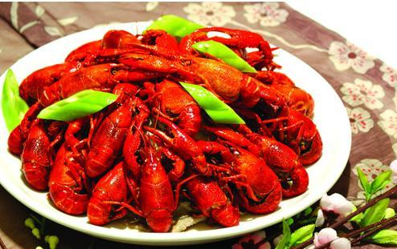
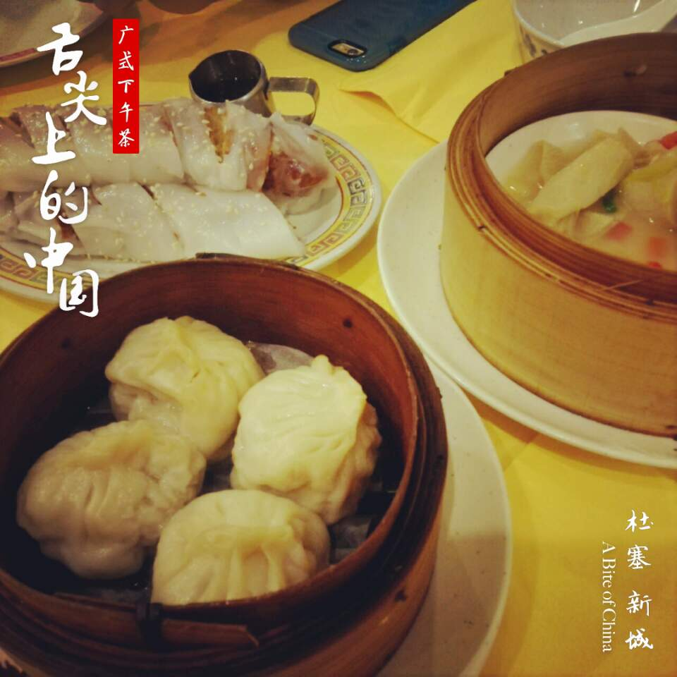
Chinese food
02
02

Slide 8
MY FEELING

Slide 9
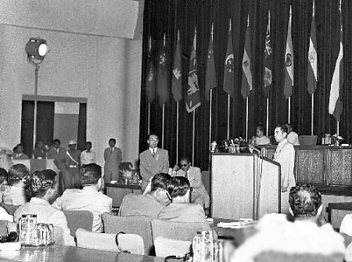
My feeling
求同存异
Seeking common ground while putting aside differences

Slide 10
That’s all. Thank you！

